Slide 1
Synthetic DSP Approach for Novel FPGA-Based Measurement of Error Vector Magnitude
Devin Morris
Dr. William Eisenstadt
Andrea Paganini
Mustapha Slamani
Tim Platt
John Ferrario
University of Florida
IBM System & Technology Group

Slide 2
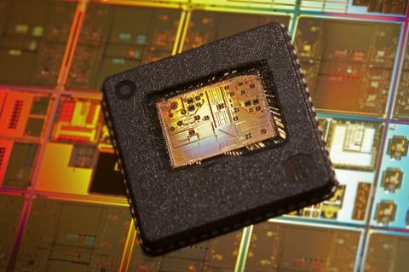
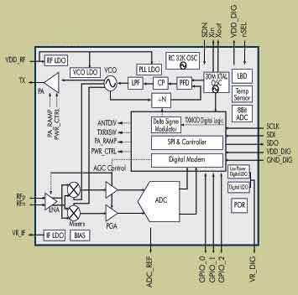
Purpose
IC’s becoming more complex
More difficult or impossible to conduct de-embedded test
Need a test solution to measure performance at both the component and system level
Want to keep test time, complexity, and cost down
Develop a pathway to implementation in ATE

Slide 3
Presentation Outline
Background
Modulated Signals
I/Q Constellation Analysis
EVM
Motivation for EVM on FPGA
Experimental Findings
Identify critical DSP components for EVM
Quantify errors and impairments in process that effect EVM accuracy
Optimize design constraints for FPGA approach to minimize error
Test Case
Conclusion
Future Work

Slide 4
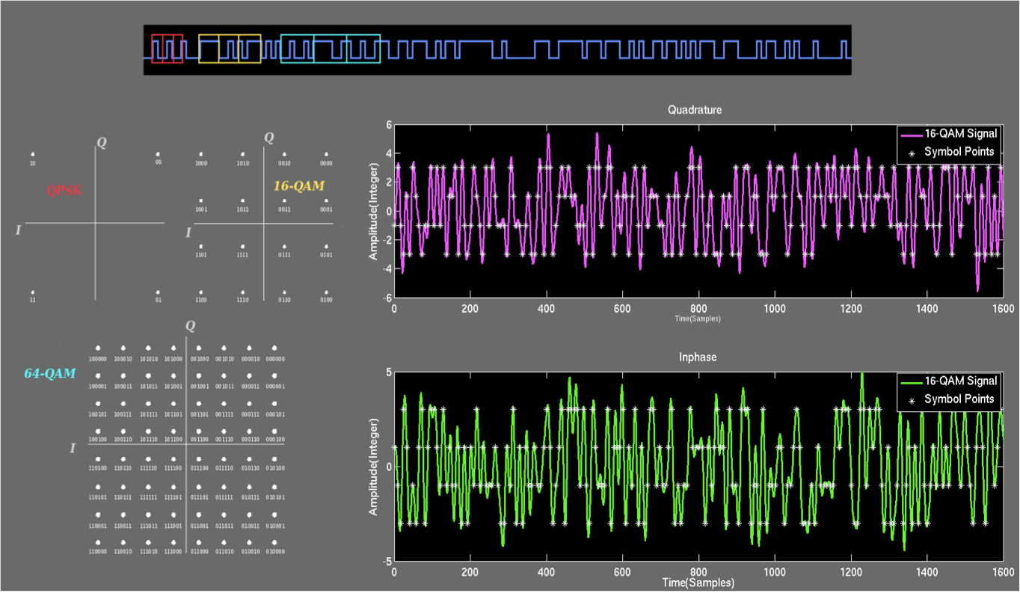
Background: Modulation

Slide 5
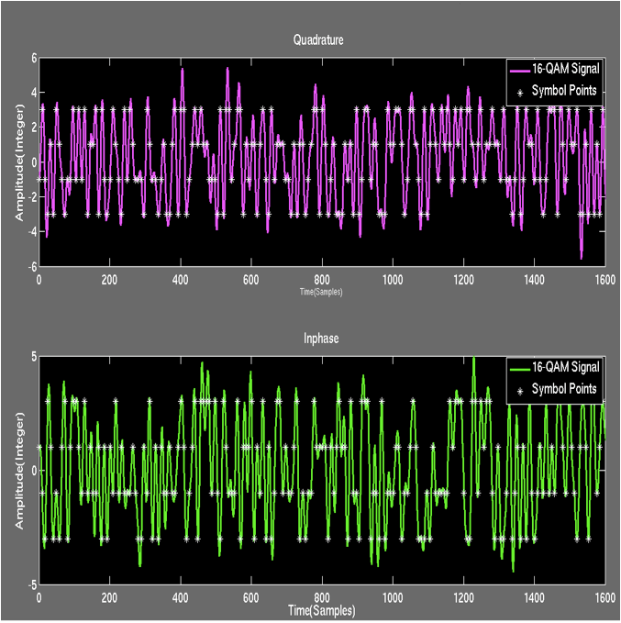
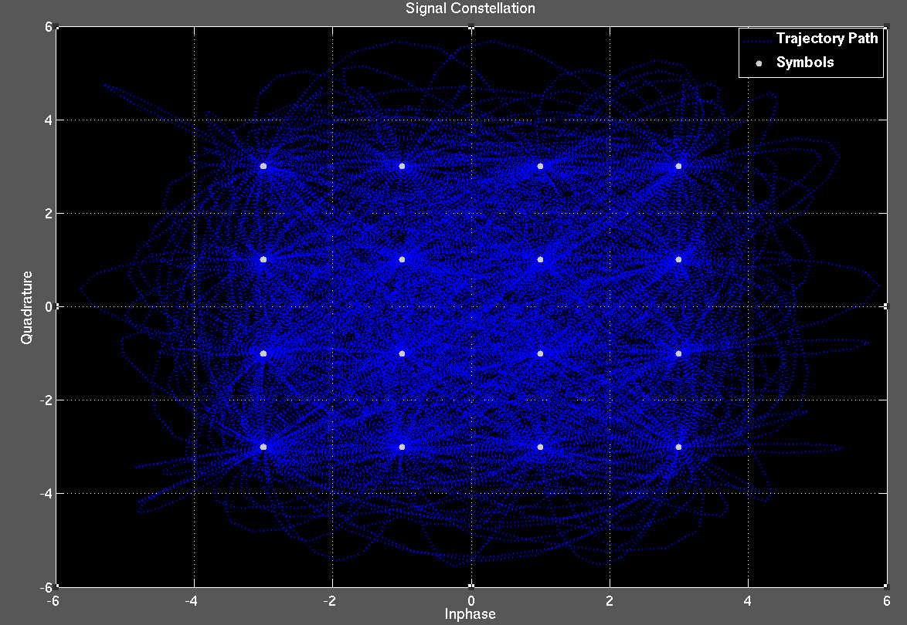
Background: I/Q Translation

Slide 6
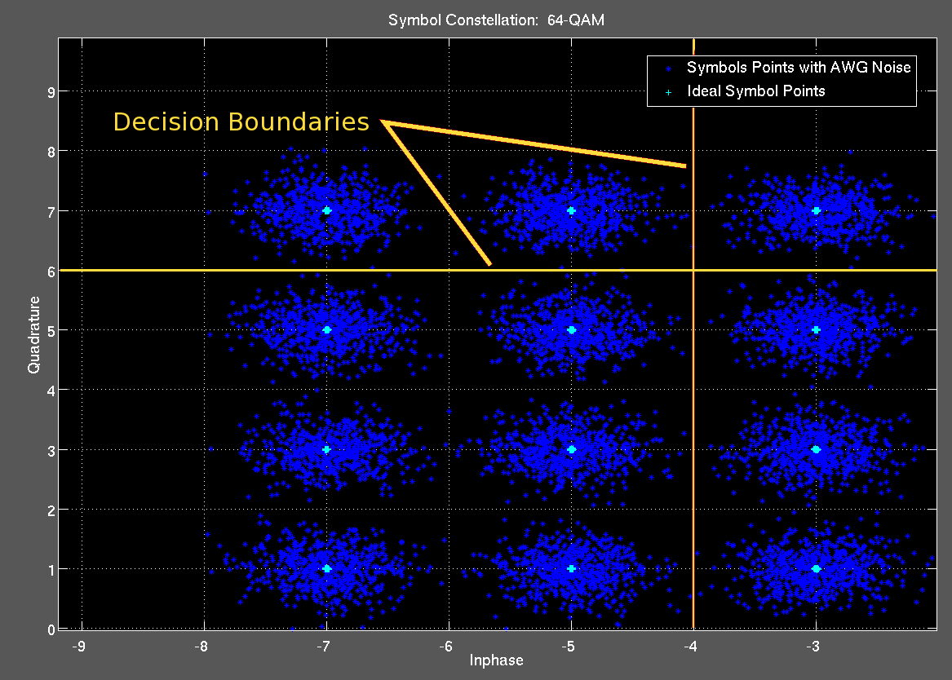
Computing EVM

Slide 7
Scope of Measurement

Slide 8
EVM Measurement Overview
Difficulties
EVM is a computationally intensive test
Need lots of averaging to produce repeatable results
Requires high fidelity in the ATE receive path: hardware & DSP
Need approach that optimizes accuracy and test time
Notes:
So here’s the overall setup
Explain where the FPGA fits in to the test system
What are the difficulties
Lots of DSP stages, complex math
EVM is highly sensitive, need averaging to get stable/reliable answer
Need to keep test system error out of measurement
Here’s what we need to address first: filter error
Downsream DSP components accuracy relate directly to the performance of the filter implmenentation
3 main resaons
- Flexibility
Accuracy
Speed
Matching of the pulse shaping filters important,

Slide 9
Prior Work
Model-based EVM
Extract EVM for distortion tests: AM-AM/AM-PM, IMD, IP3, SNR
Optimized test vectors and pass/fail boundaries
Delta EVM
Bypass demodulation stages by direct subtraction of test signal from measured DUT signal
FPGA-based Synthetic Instruments
Synthesizing DSP elements in reconfigurable, high-speed FPGA logic
Notes:
Optimized test vectors: identify “worst-case” scenario input vectors, and then establish new pass/fail criteria based on the performance of the worst-case input
Problem: requires highly accurate models → SoC and complex ICs difficult to model
Delta EVM: split input signal into receiver and DUT and then subtract 2 signals to find EVM
Agilent 89604A/AN uses this: 0.5% - 1.3% accuracy
Problem: repeatability is dependent on test equipment fidelity, accurate results may require large data sets and high oversample rates, DUT delays can vary
FPGA-based EVM: synthesize DSP necessary to reduce data needed to compute EVM/compute EVM on FPGA → processing in real-time, parallel processing
Problem: LIMITED ARITHMETIC RESOURCES, limit the scope & optimize demodulation algorithms, need to establish design criteria for insured accuracy

Slide 10
FPGA-based DSP Advantages
Flexibility
Reconfigurable DSP architecture
Advanced toolsets to support development
Constantly expanding capabilities with more gates
Speed
High-speed I/O: between data capture devices & PC digital buses
Take advantage of dedicated DSP resources
Parallel processing & distributed arithmetic architectures
Task FPGA with handling large data sets & computationally intensive processes
Notes:
Answer why we would use an FPGA to do this measurement
Handle the large data sets
Could support MIMO with more gates

Slide 11
Why Focus on Filter?
Flexibility
Reprogram filter coefficients → Support multiple standards
Speed
Ideal structure for parallel architecture
Clock can operate above sample rate
Accuracy
DSP front-end “noise” contributor
Downstream DSP is dependent on filter accuracy
Focus on three impairments: Filter Mismatch, Filter Order, Fixed-point effects
Notes:
As we saw from previous slide, filter is first digital stage of measuring EVM
Downsream DSP components accuracy relate directly to the performance of the filter implmenentation
3 main resaons
- Flexibility
Accuracy
Speed
Measurement speed, accuracy and repeatability are paramount in ATE.
EVM is a sensitive measurement that can be made more consistent by averaging
Averaging takes up time, so if we can reduce residual noise contributors without the use extra DSP, that would be advantageous
The filter is the first DSP stage in the EVM process, then symbol timing recovery, then the actual EVM
If we can set design limits based on accuracy guarantees, we can optimize are measurement on the FPGA

Slide 12
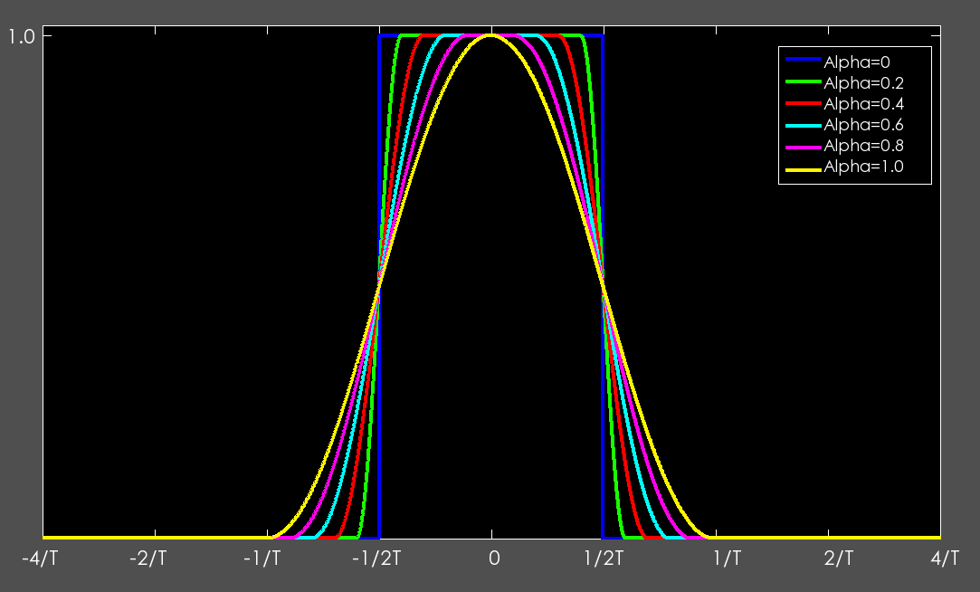
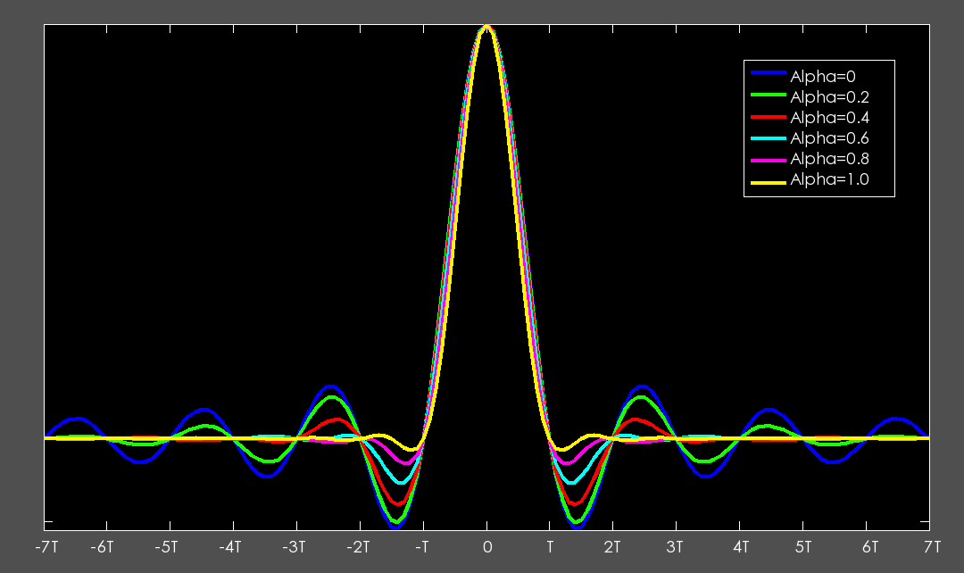
Filter Mismatch
Frequency Response
Impulse Response
Notes:
Downsream DSP components accuracy relate directly to the performance of the filter implmenentation
3 main resaons
- Flexibility
Accuracy
Speed
Measurement speed, accuracy and repeatability are paramount in ATE.
EVM is a sensitive measurement that can be made more consistent by averaging
Averaging takes up time, so if we can reduce residual noise contributors without the use extra DSP, that would be advantageous
The filter is the first DSP stage in the EVM process, then symbol timing recovery, then the actual EVM
If we can set design limits based on accuracy guarantees, we can optimize are measurement on the FPGA

Slide 13
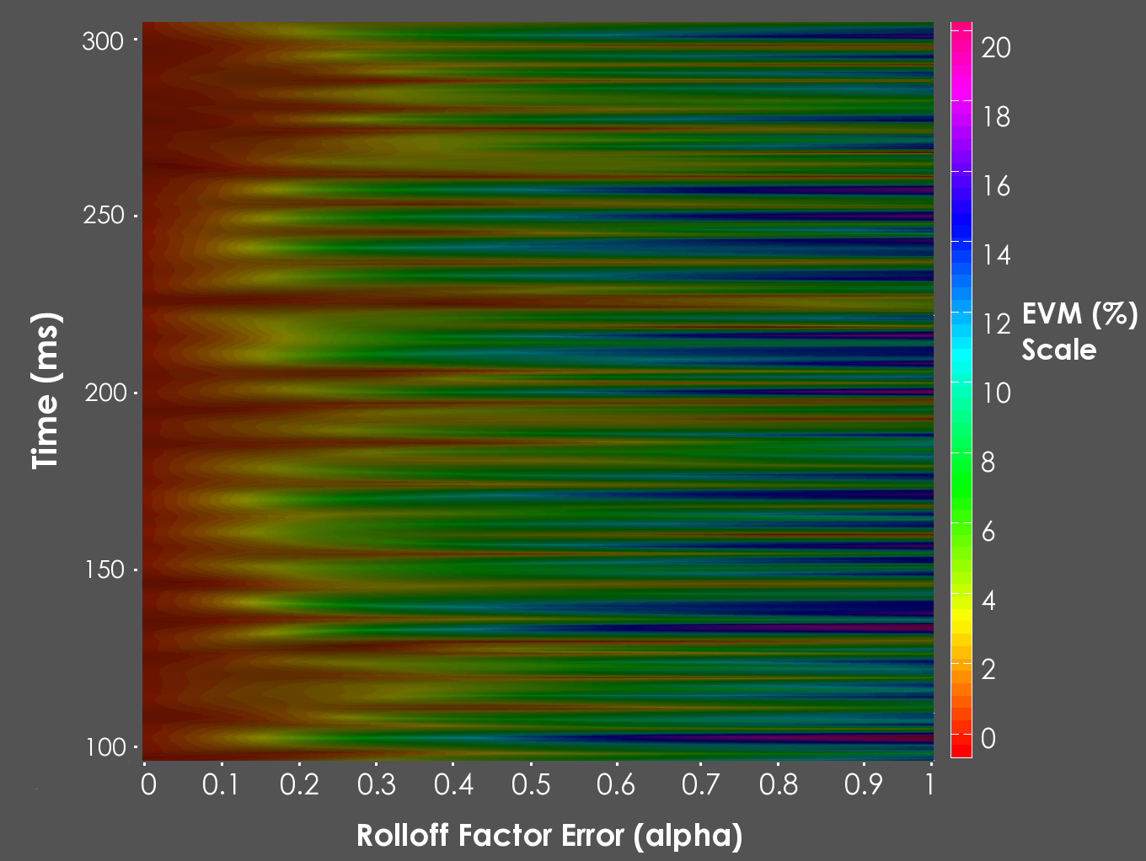
Instantaneous EVM vs. Filter Error
Notes:
The data correlates along the Rolloff factor Error axis b/c each one of these mismatch systems is fed the same data in parallel.
If you take a vertical sliver of data, that data has a pseudo random distribution

Slide 14
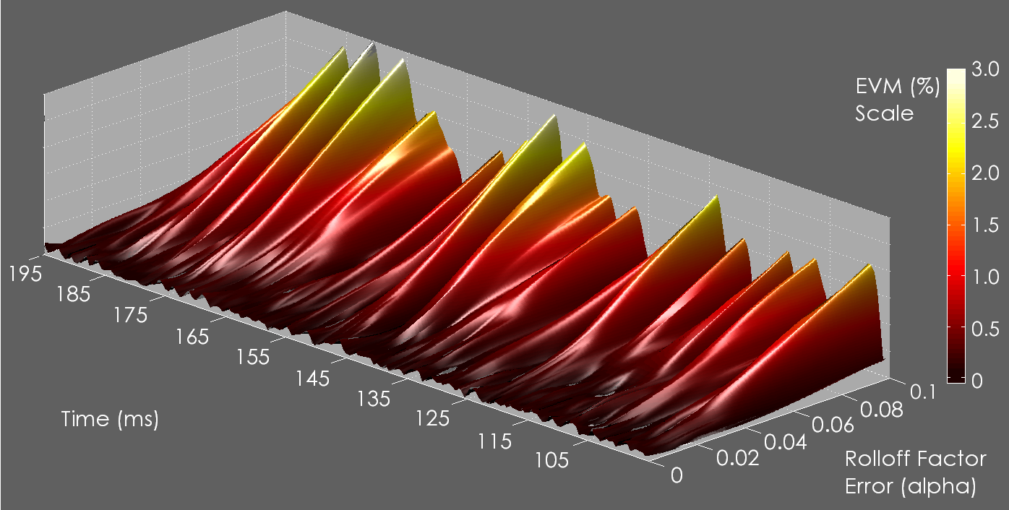
EVM vs. Filter Mismatch Error
Notes:
Note the behavior is random
Also note how sensitive the measurement is to this error
Smaller deviations/variation
peaks at 1-2 %- could also use this data for calibration/equalization

Slide 15
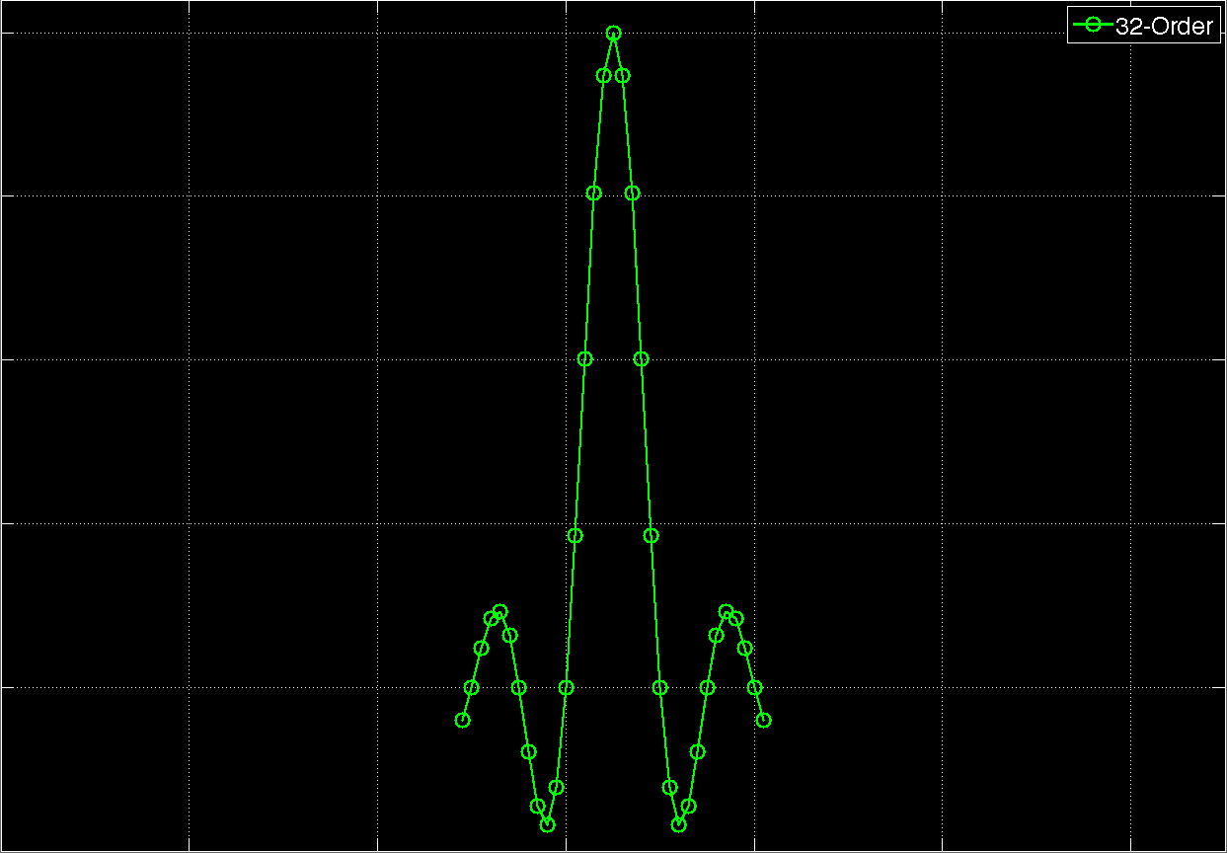
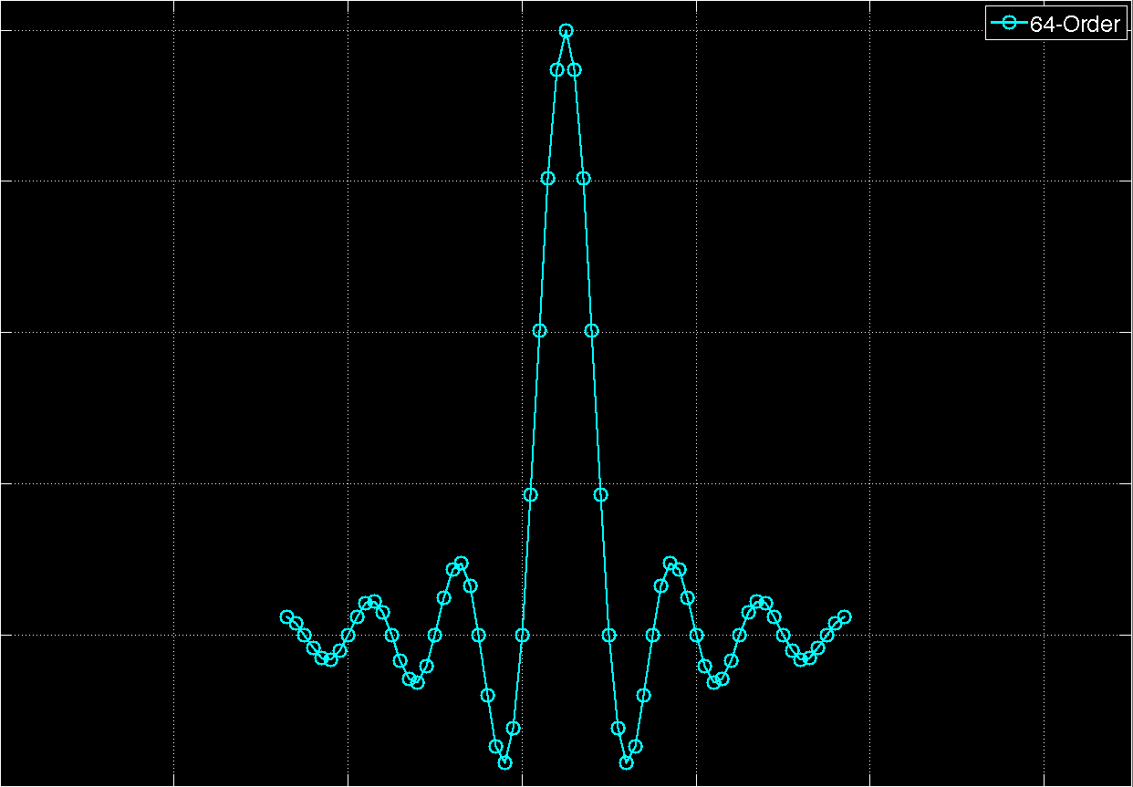
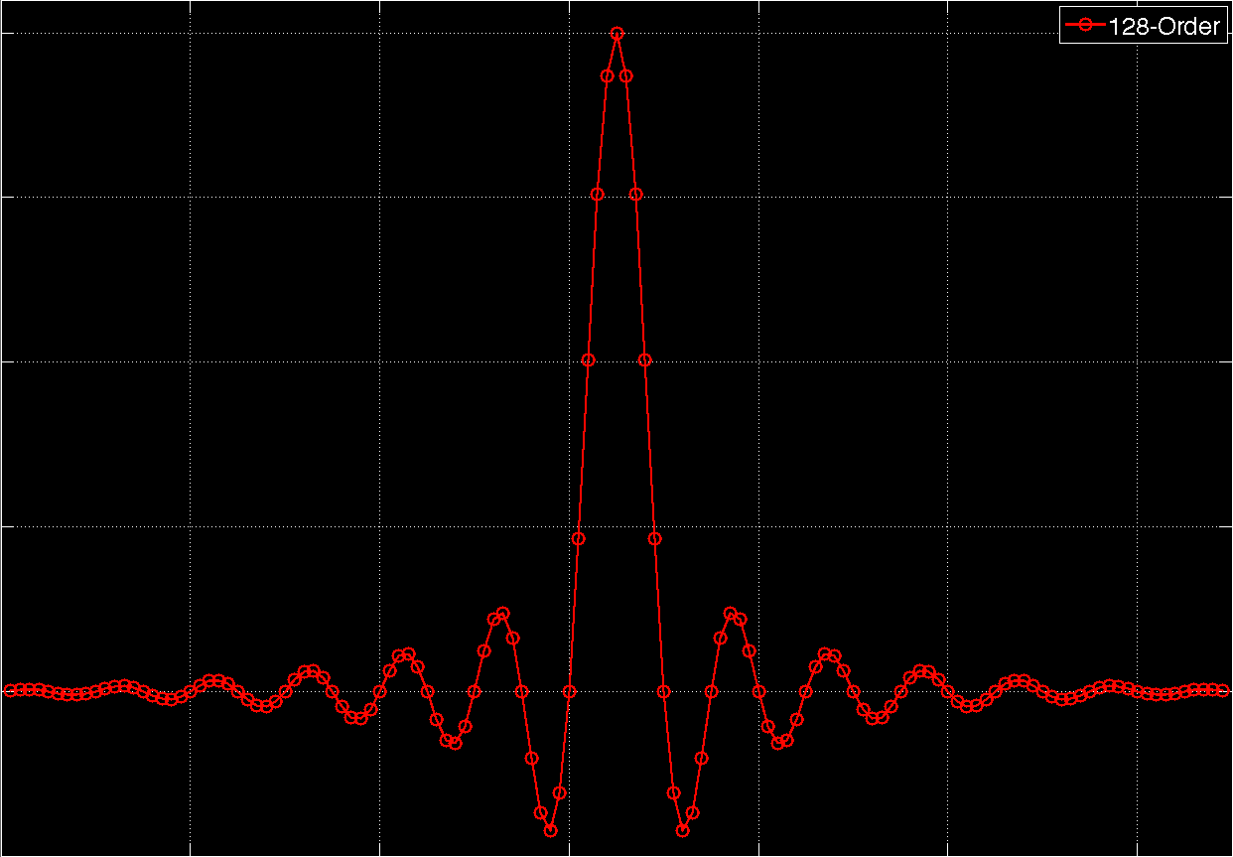
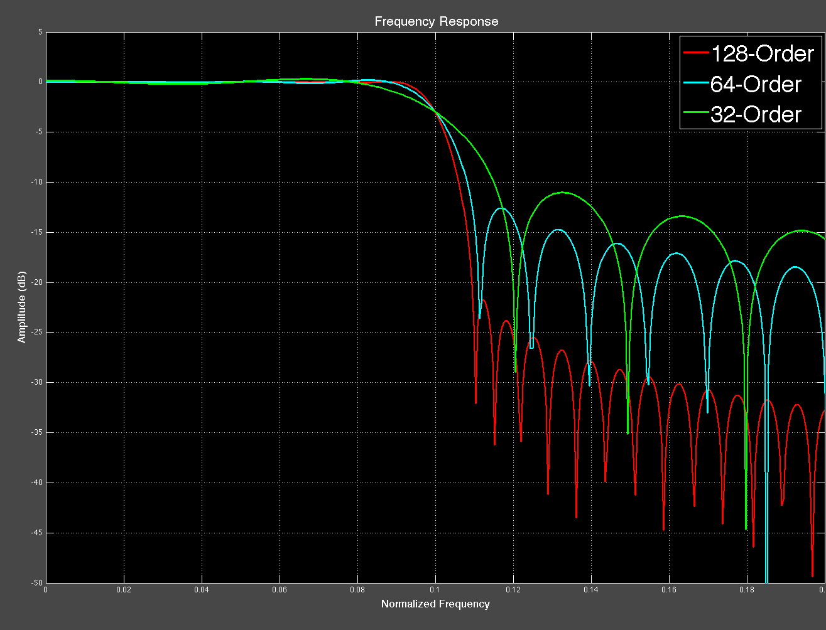
Filter Order
32-Order
64-Order
128-Order
Frequency Response Comparison
Notes:
Downsream DSP components accuracy relate directly to the performance of the filter implmenentation
3 main resaons
- Flexibility
Accuracy
Speed
Measurement speed, accuracy and repeatability are paramount in ATE.
EVM is a sensitive measurement that can be made more consistent by averaging
Averaging takes up time, so if we can reduce residual noise contributors without the use extra DSP, that would be advantageous
The filter is the first DSP stage in the EVM process, then symbol timing recovery, then the actual EVM
If we can set design limits based on accuracy guarantees, we can optimize are measurement on the FPGA

Slide 16
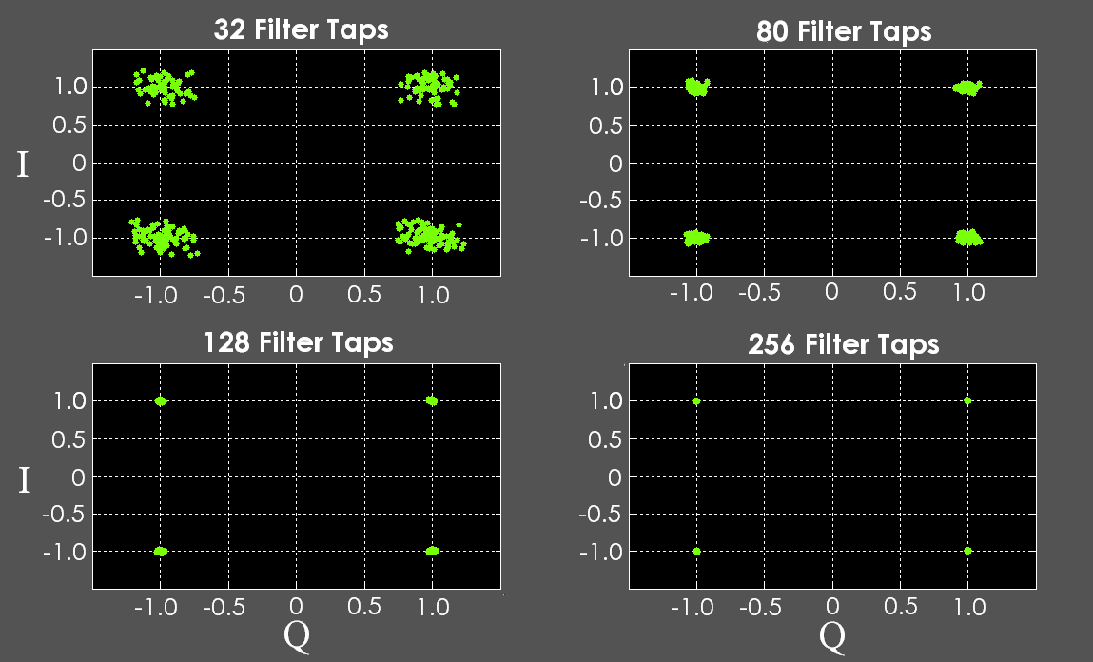
Filter Order vs. Recovered Symbols
Notes:
Filter order relates to design optimization:
Smaller order -> smaller footprint -> faster response -> easier to parallel
Larger order -> longer time response -> more accurate freq response -> lower residual EVM
Directly affects symbol timing recovery performance -> directly affects EVM measurement performance
Filter order, essentially filter mismatch -> random error behavior -> additive “noise” that cannot be removed remove without calibration

Slide 17
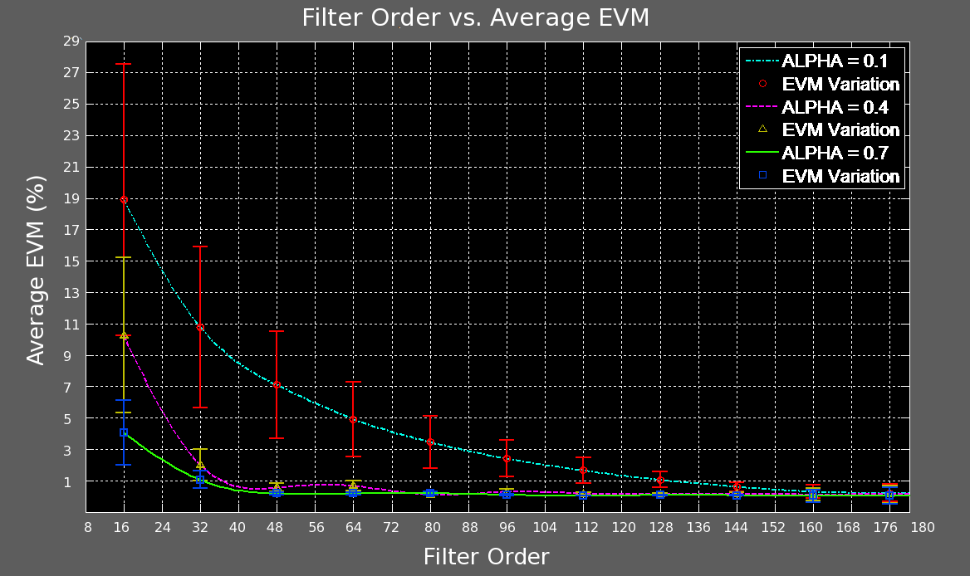
EVM vs. Filter Order

Slide 18
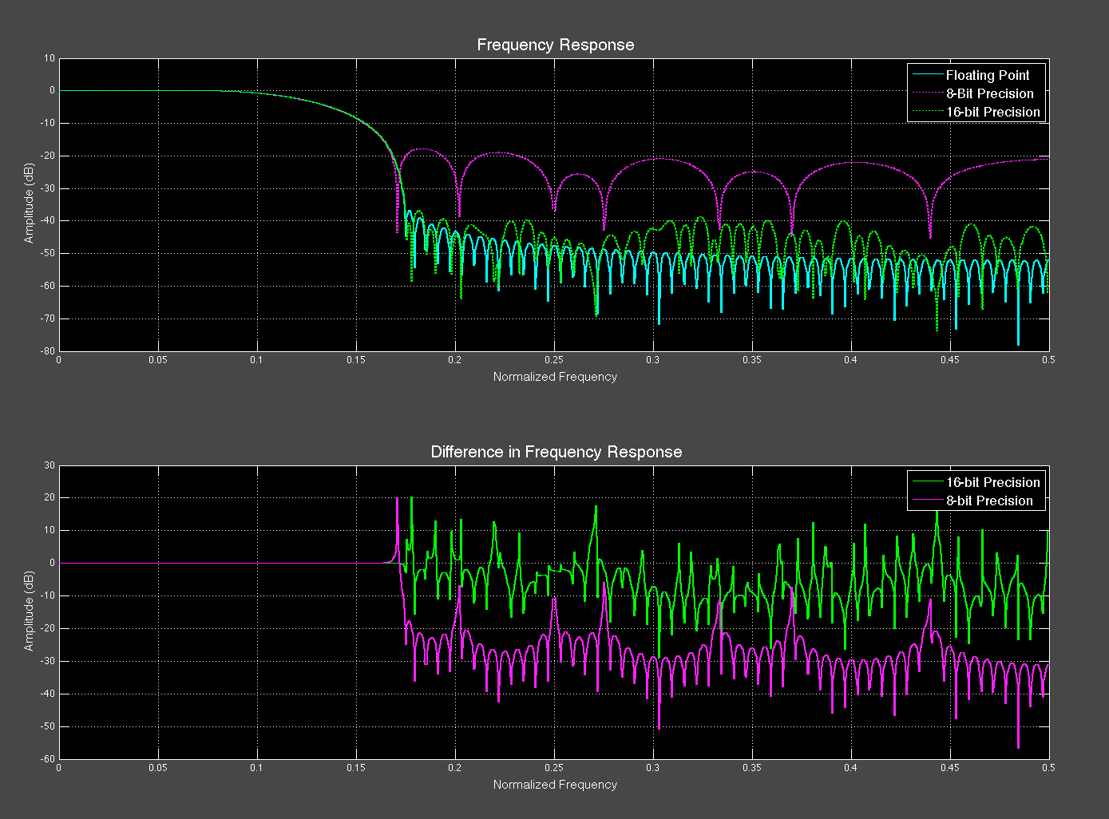
Fixed-Point Effects
Alpha | EVM Error (8-bit) | EVM Error (16-bit)
0.1 | 0.19 | 0.0004
0.2 | 0.45 | 0.0002
0.3 | 0.18 | 7.38e-6
0.4 | 0.34 | 6.36e-6
0.5 | 0.25 | 0.0001
0.6 | 0.29 | 0.0001
0.7 | 0.25 | 4.34e-5

Slide 19
Summary of Optimization
Mismatch
Quantified range of appreciable error at low and extreme mismatch
Nominal EVM Error Range: 0.1% - 0.7%
Filter Order
Found an optimum filter order for design footprint and accuracy
EVM error: less than ~0.5% with 160taps
Fixed-Point Effects
Compared 8-bit &16-bit precision against residual effects on EVM: negligible for 16-bit (<0.0004%)

Slide 20
Test Case: System Overview
FPGA
Analog/RF & Mixed Signal
I
Q
Notes:
- Main thing is we reduce the data overhead passed to the controller PC
Controller PC should be dedicated to controlling instrumentation, executing test plan
FPGA handles dedicated processing
- Pass only the symbols: reduce the amount of data overhead passed to the PC by 8x – 100x
Compute EVM on the FPGA: averaging lots of clock cycles, faster clock cycles on FPGA → faster compute time

Slide 21
Resources Overview
Altera Cyclone III
24,624 Logic Elements
132 Embedded Multipliers
80 MHz Clock Rate
16-bit arithmetic precision
Test Signal
1MHz QPSK Symbol Rate
8x Oversampled
78 dB SNR
59%
6%
10%
Notes:
By saving space, we leave room for parallelization of algorithms and EVM tests for multiple DUTs (MIMO & new standards: LTE, WiMax WiBro, 802.11n)
Notes:
Know what percentage a 256tap,512tap 1024tap filters occupy:
256tap: 10% (2314/24624)
512tap: 17% (4255/24624)
1024tap: 23% (5895/24624) hypothesized:
Emphasize reasonable usage of resources
know the size of larger FPGAs:
Altera Stratix IV&V; up to 622.000 (current design would be ~2%)
Xilinx-Virtex 5&6 – up tp 758,784 current design would be ~less than 1.5%

Slide 22
Test Results
Test Time
Type | Test Time
MATLAB w/ Intel Core 2 Duo (100 EVM samples) | 105 ms
Optimized EVM Production Test * | 50 ms
NI PXI Vector Analyzer (multicore PC)** | 8 ms
FPGA Solution (100 EVM samples) | 0.4 ms
Test Accuracy
QPSK Signal | Reference EVM | FPGA EVM | Error
Alpha=0.1 | 3.67% | 3.58% | -0.09%
Alpha=0.2 | 3.84% | 3.53% | -0.31%
Alpha=0.3 | 3.93% | 4.04% | 0.11%
Alpha=0.4 | 3.91% | 3.85% | -0.06%
Alpha=0.5 | 3.90% | 4.18% | 0.28%
Notes:
If you take max/min error, roughly within 0.6% which is close to what was predicted for the given filter order
*- taken from Evaluation Engineers website: www.evaluationengineering.com/index.php/solutions/ate/reducing-evm-test-time-and-identifying-failure-mechanisms.html by Keith Schaub
** -from NI website & PDF:

Slide 23
Conclusion
Overview
Presented approach using FPGA co-processor to improve test time
Identified & characterized critical DSP
Development path for optimized speed and measurement precision → EVM accuracy within less than 1%
10x reduction in test time
Future Work
Expand optimization to symbol timing recovery
EVM test on standards: WiFi, Bluetooth, etc.
Questions?
Notes:
- Shown that can reduce residual error below 1% with optimization of filter and symbol timing recovery
- Test time better than 100x over PC based EVM computation

Slide 24
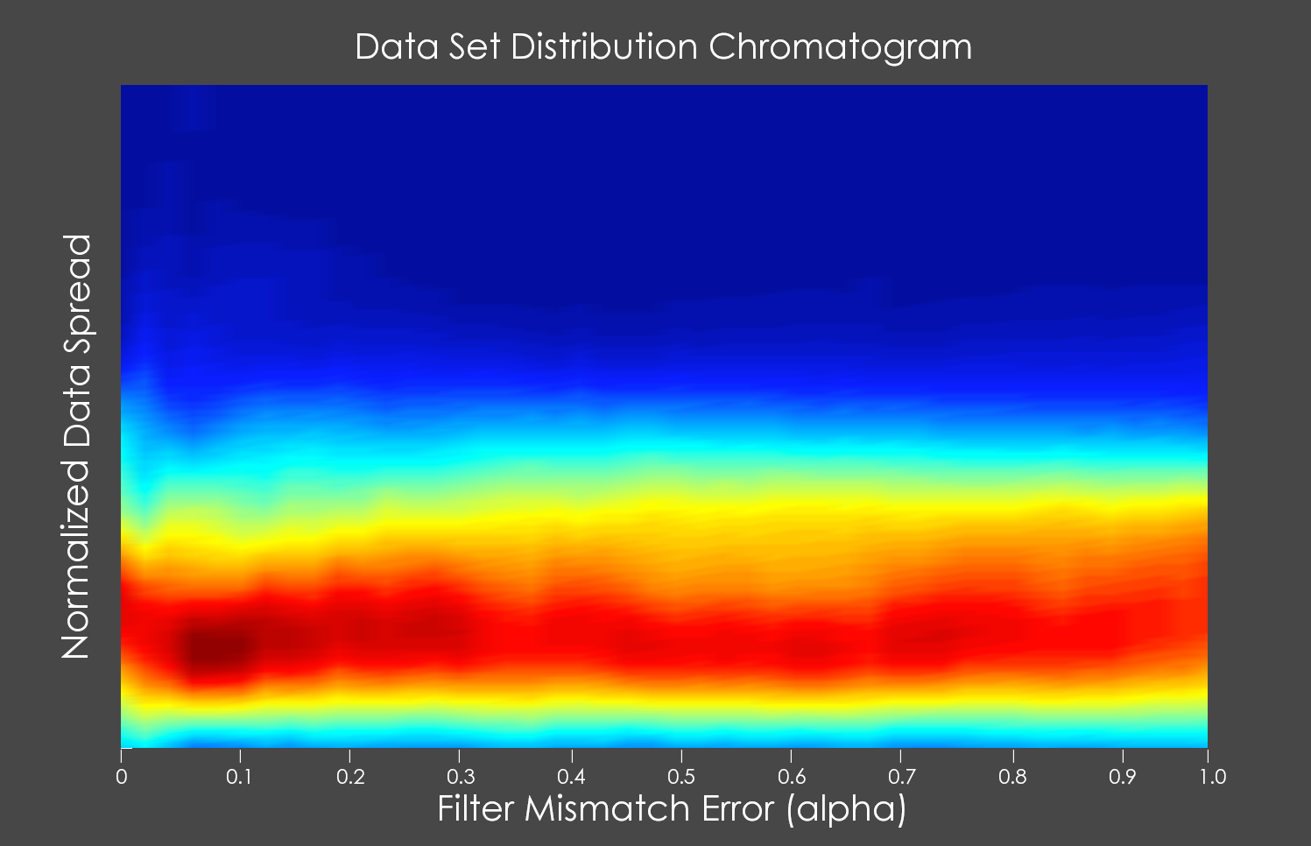
Reference Slide
Notes:
Update this slide with new color distribution

Slide 25
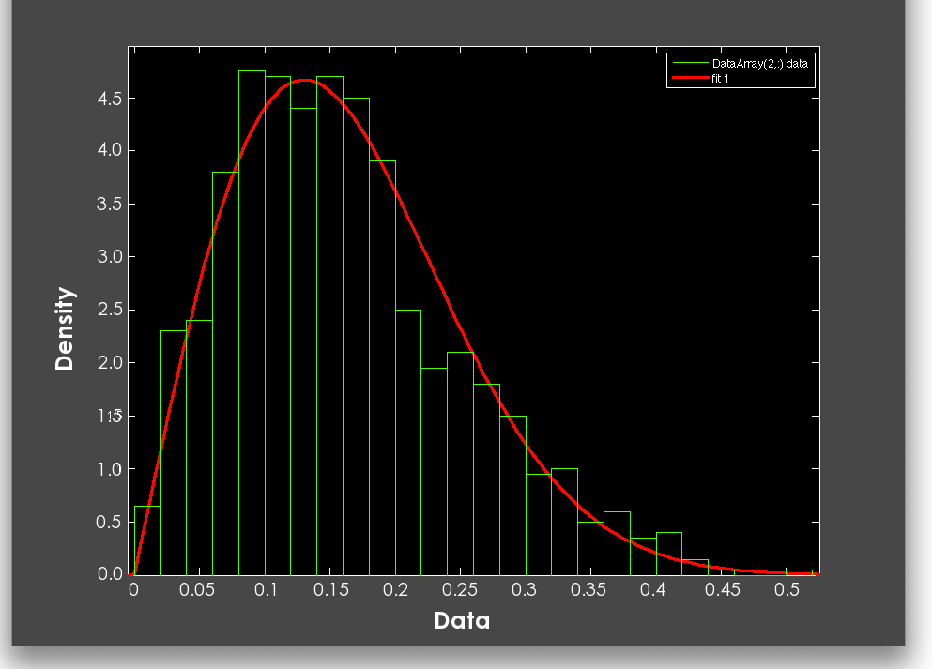
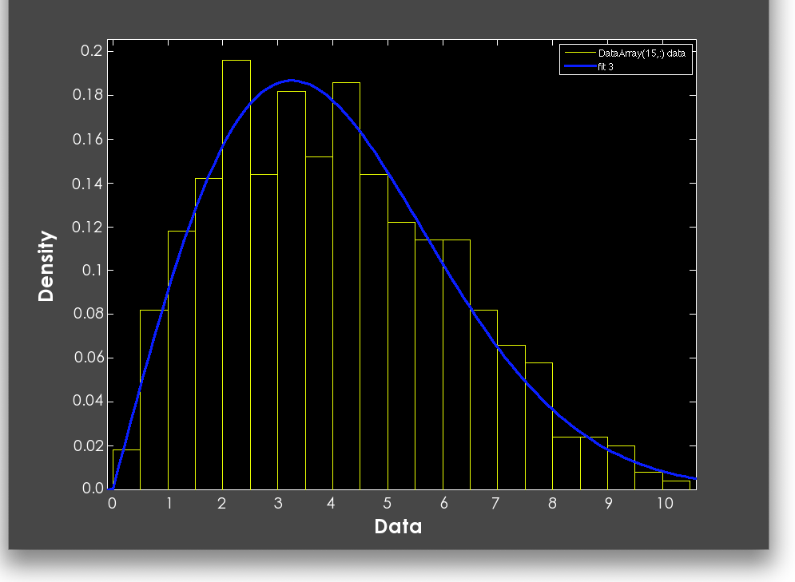
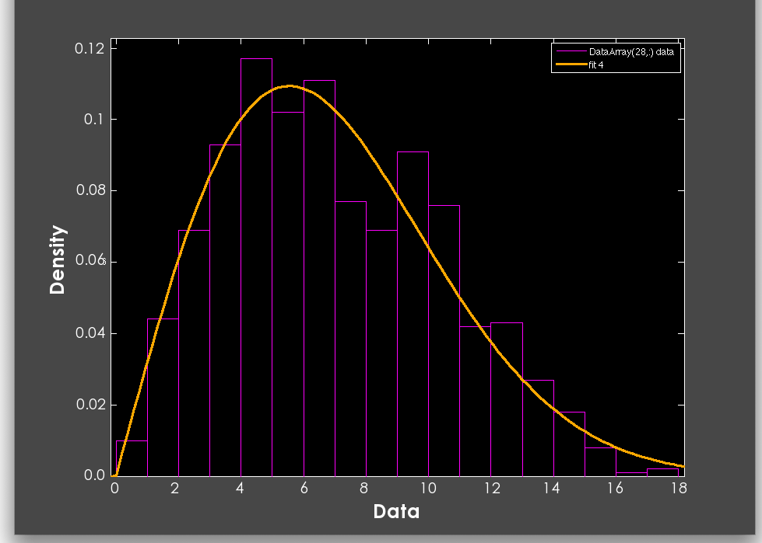
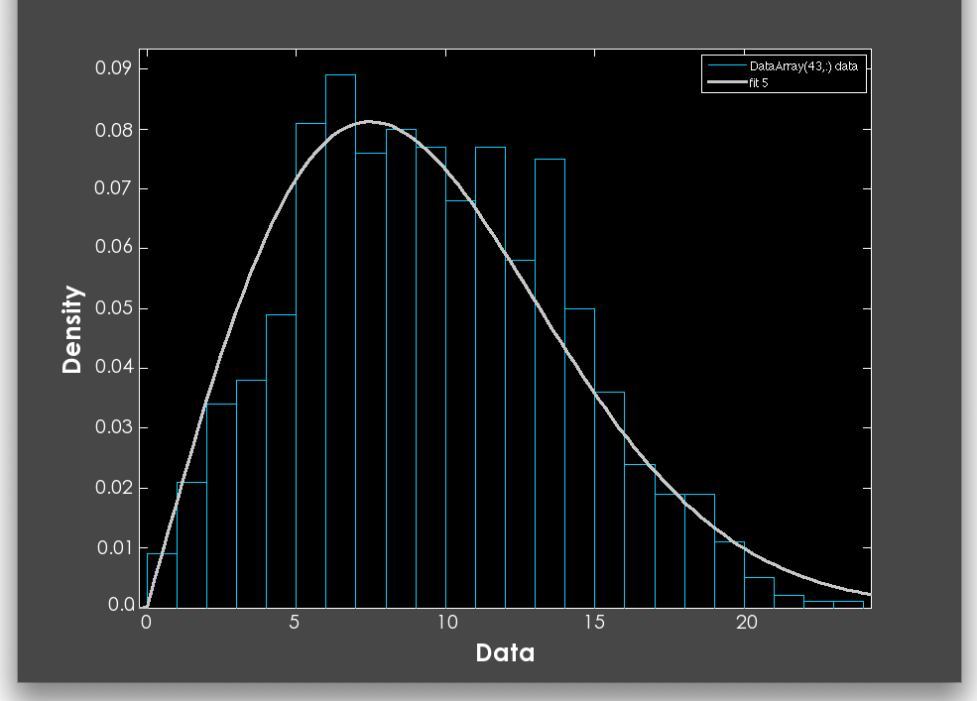
Reference Slide
Notes:
Update this slide with new color distribution

Slide 26
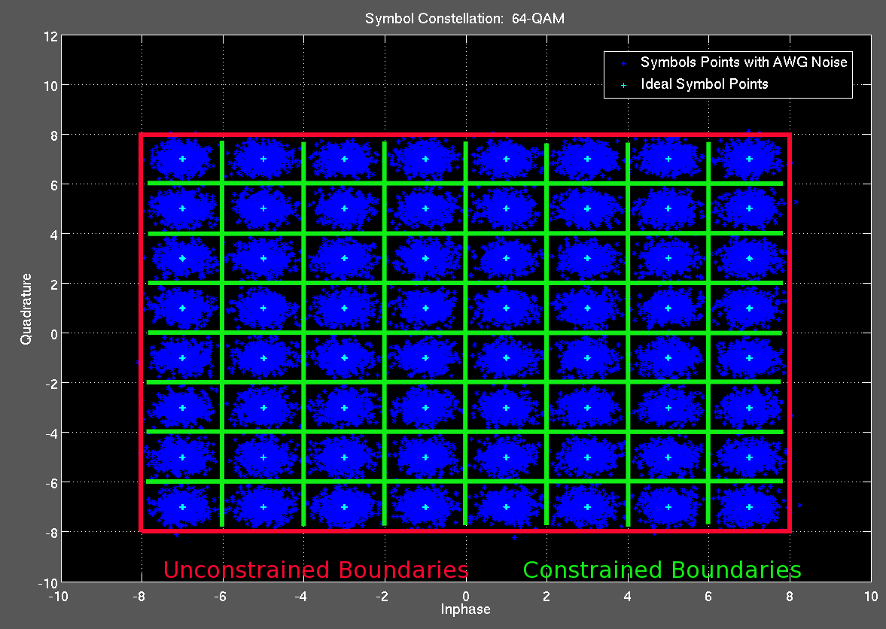
Reference Slide

Slide 27
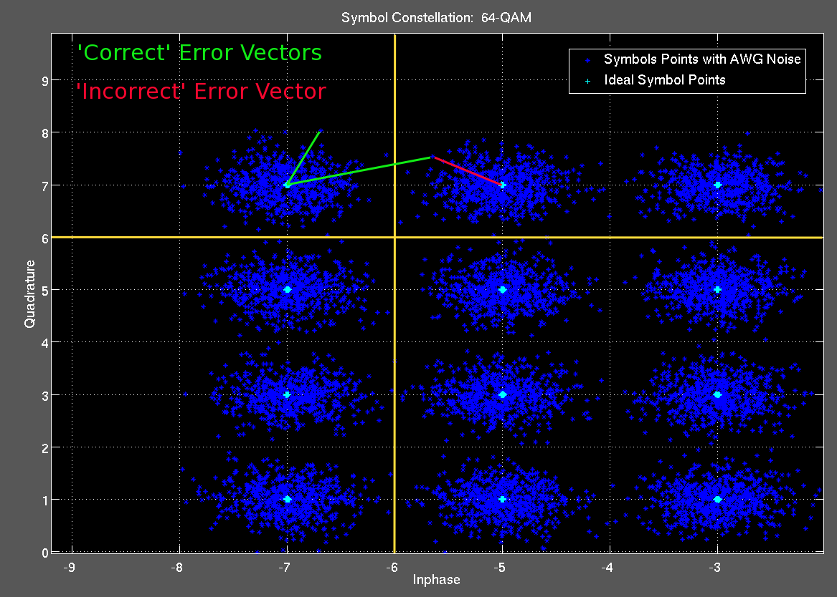
Reference Slide

Slide 28
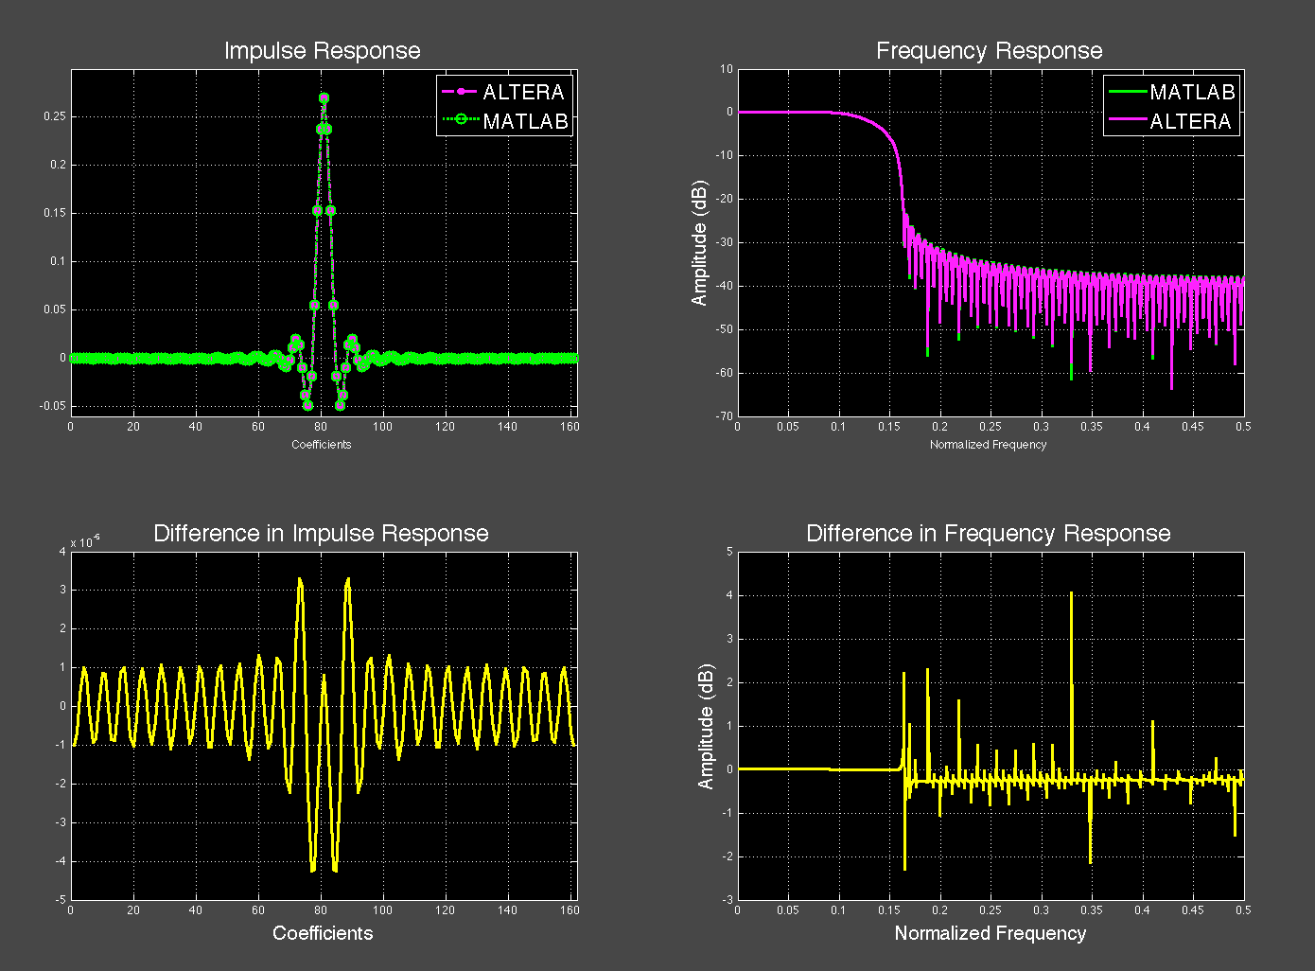
Ref Slide: Filter mismatch
Notes:
Interesting Notes: Difference EVM or Delta EVM can be difficult due to varying delays through different DUTs
Also note, my correlation technique, coupled with oversampling at 64x & 90degree IQ phase ambiguity correction would remedy this

